Slide 1

SCSA1402-COMPUTER ARCHITECTURE AND ORGANIZATION

Slide 2

SCS1207 : COMPUTER ARCHITECTURE AND ORGANIZATION
UNIT 2 - DATA PATH DESIGN :
Computer arithmetic :
Addition
Subtraction
Multiplication and Division algorithms
Floating Point Arithmetic operations
Microprogrammed Control :
Control memory
Address sequencing
Microprogram Example
Design of Control unit
Example Processor design

Slide 3
Algorithm for addition and subtraction
Arithmetic instructions in digital computer manipulate data to produce re­sults necessary for the solution of computational problems.
These instructions perform arithmetic calculations and are responsible for the bulk of activity involved in processing data in a computer.
The four basic arithmetic operations are addition, subtraction, multiplication and division.
From these four operations, it is possible to formulate other arithmetic functions and solve scientific problems by means of numerical analysis methods.

Slide 4
The magnitude of the two numbers be A and B.
When the signed numbers are added or subtracted we find that there are eight different conditions to consider, depending on the sign of the numbers and the operation performed.
When two equal numbers are subtracted, the result should be +0 not -0.
When the signs of A and B are identical add the two magnitudes and attach the sign of A to the result.
When the signs of A and B are different (identical), compare the magnitudes and subtract the smaller number from the larger.
Choose the sign of the result to be the same as A if A > B or the complement of the sign of A if A < B. If the two magnitudes are equal, subtract B from A and make the sign of the result positive.

Slide 5
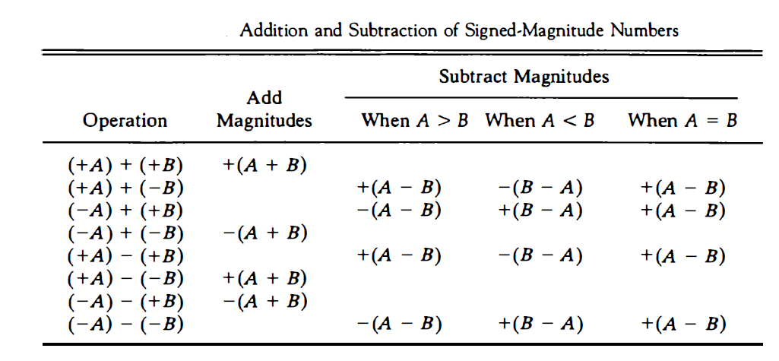
ADDITION AND SUBTRACTION OF SIGNED MAGNITUDE NUMBERS

Slide 6
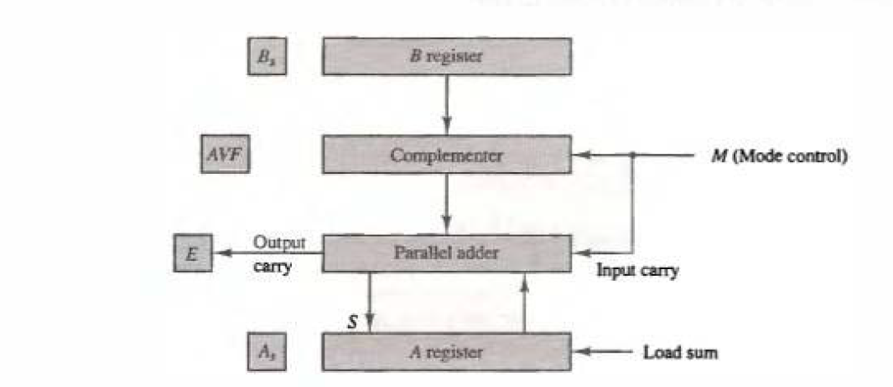
Hardware implementation for signed addition and subtraction
It consists of registers A and B and sign flip-flops As, and Bs .
The add-overflow flip-flop AVF holds the overflow bit when A and B are added.
The addition of A plus B is done through the parallel adder.
The S (sum) output of the adder is applied to the input of the A register.
The complementer provides an output of B or the complement of B depending on the state of the mode control M.

Slide 7
Parallel Adder- Full Adder and complementer-Ex-OR gate
The output carry is transferred to flip-flop E, where it can be checked to determine the relative magnitudes of the two numbers.
The M signal is also applied to the input carry of the adder.
When M = 0, the output of B is transferred to the adder, the input carry is 0, and the output of the adder is equal to the sum A + B.
When M = I, the l's complement of B is applied to the adder, the input carry is I, and output S = A + BCOMPLEMENT + 1. This is equal to A plus the 2's complement of B, which is equivalent to the subtraction
A - B.

Slide 8
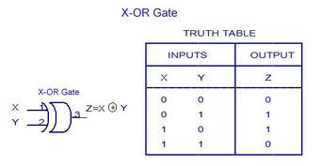

Slide 9
Hardware and algorithm for signed 2s complement addition and subtraction

Slide 10
Comparing this algorithm with its signed-magnitude counterpart, we note that it is much simpler to add and subtract numbers if negative numbers are maintained in signed-2' s complement representation.
For this reason most computers adopt this representation over the more familiar signed-magnitude

Slide 11
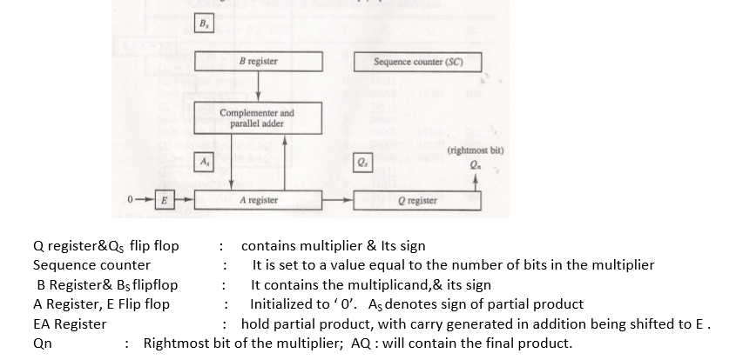
Multiplication Algorithm
Multiplicand –B 12
Multiplier – Q *3
Complementer -A&B register
Shr operation on
EAQ
0 shifted E

Slide 12
Sign of As & Bs is defined multiplier and multiplicand
E- FF flip flop
Sequence counter = multiplier bit
Qn – is the significant bit of Q register(last bit)

Slide 13
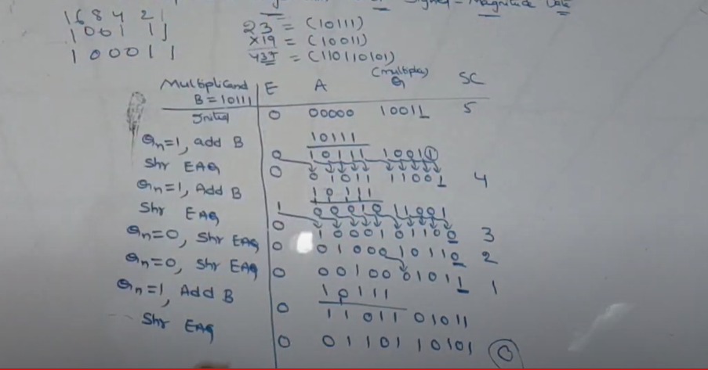

Slide 14
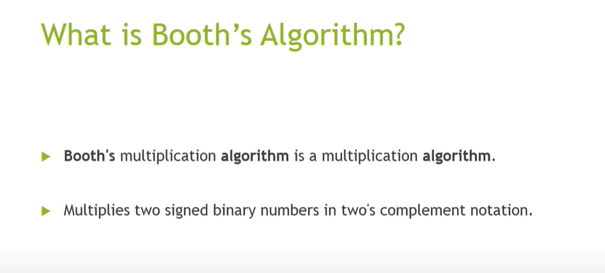

Slide 15
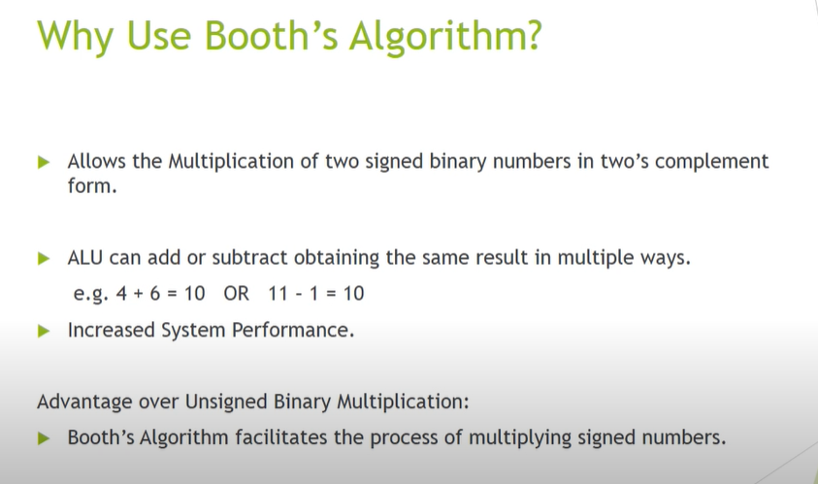

Slide 16
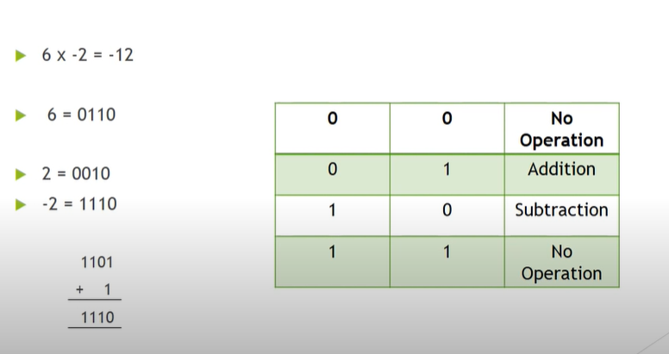

Slide 17
Booth Multiplication Algorithm
BR- Multiplicand
QR-Multiplier
Complementer- Mode control(0 or 1)
AC- Temporary register
AC&QR—asr operation
Qn-LSB,Qn+1- extra bit (FF) -0 initial bit

Slide 18
Multiplier contains 4 bits – AC register is 4 zeros
SC- 4 bits
Qn-LSB & Qn+1 extra FF
AC -Temporary Register-Partial Products

Slide 19
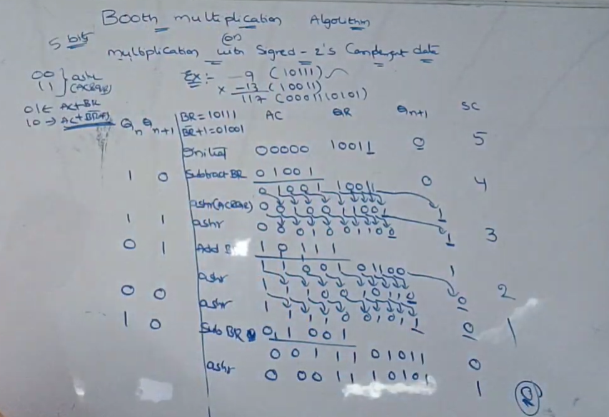

Slide 20
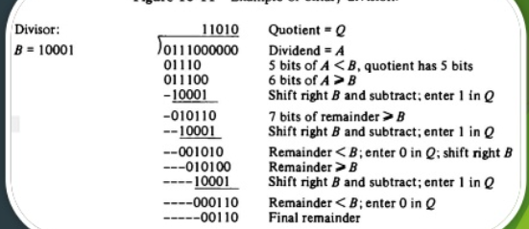
Division Algorithm

Slide 21
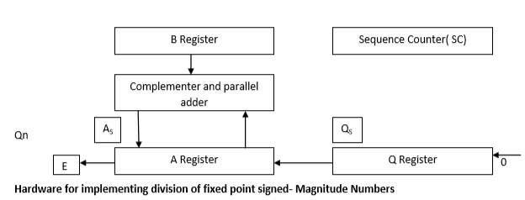
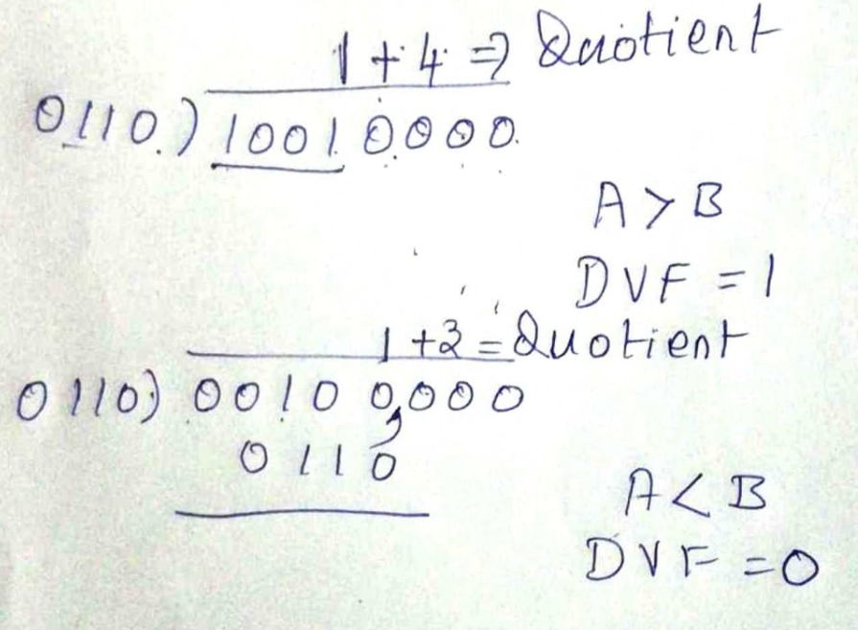
Division Algorithm

Slide 22
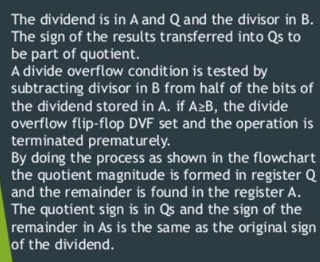
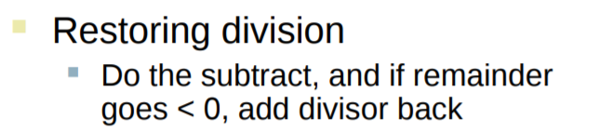

Slide 23
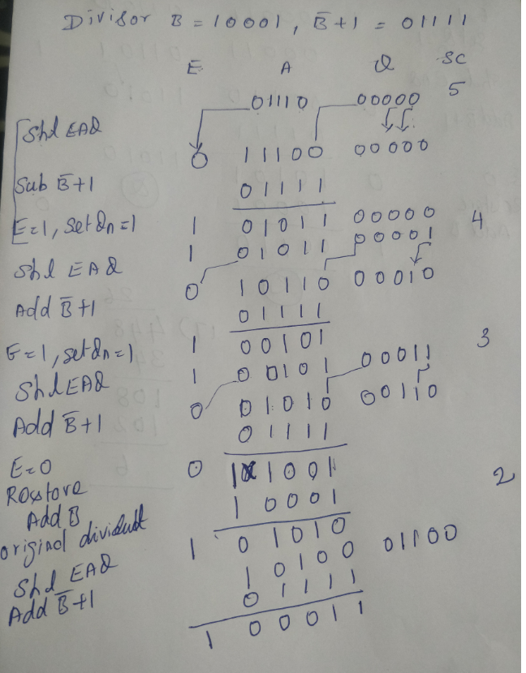
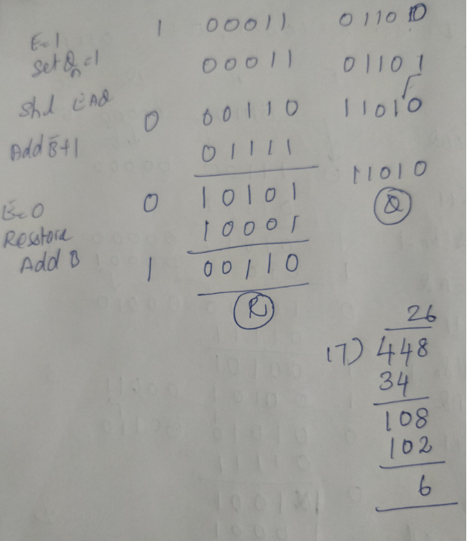

Slide 24
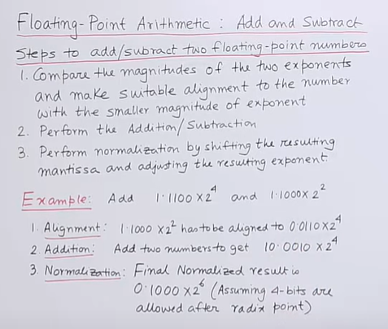
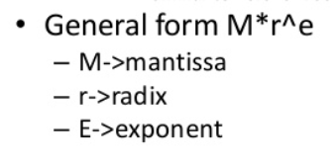

Slide 25
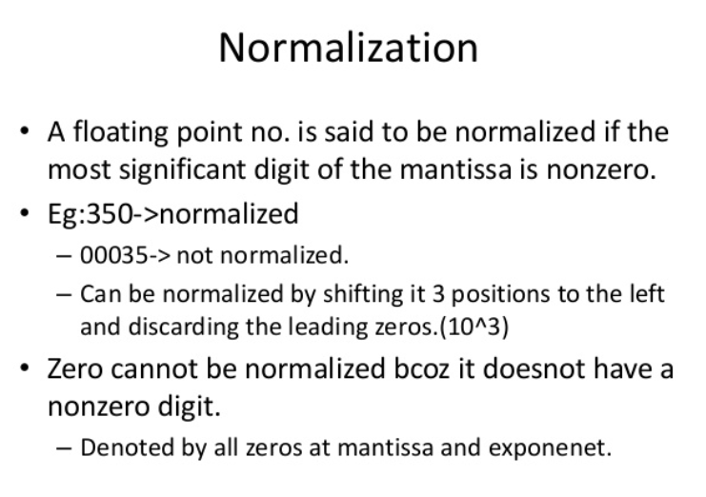

Slide 26
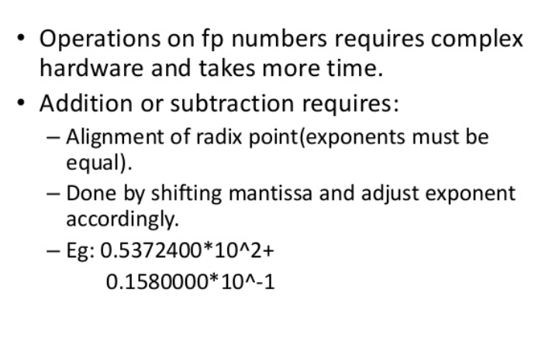

Slide 27
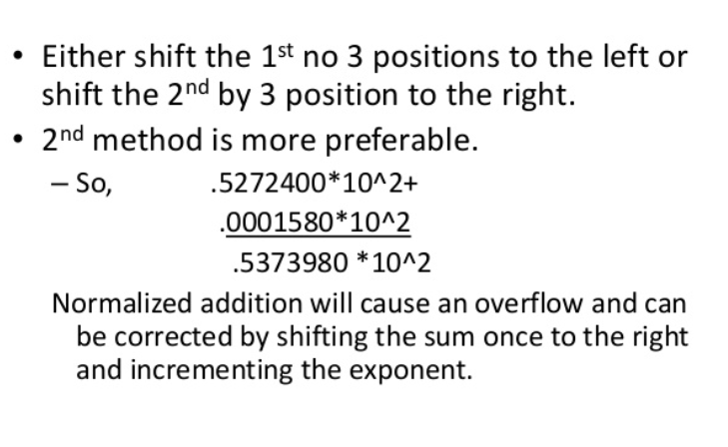

Slide 28
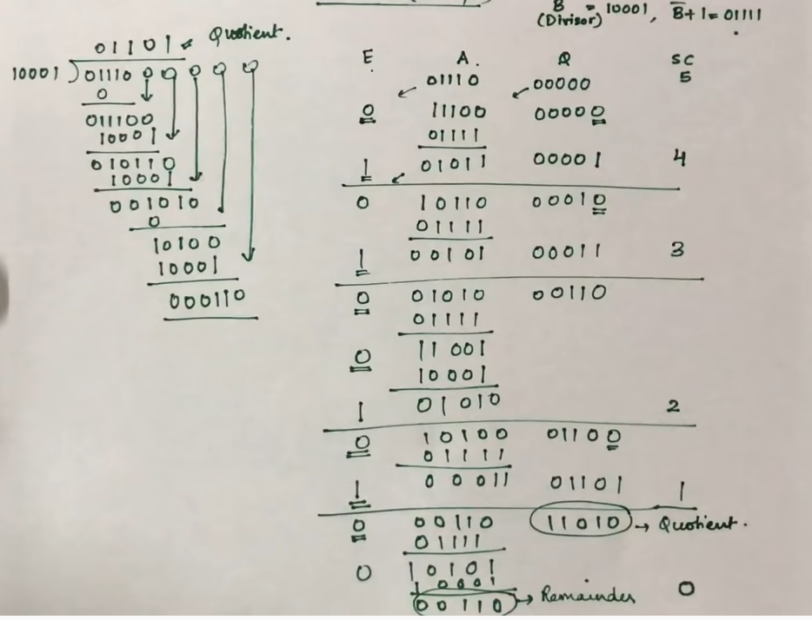

Slide 29

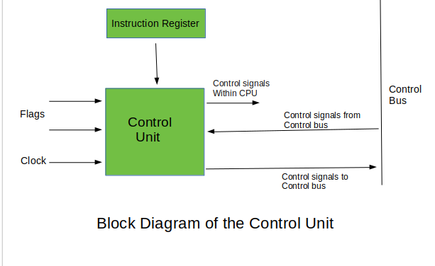
Block Diagram of control unit

Slide 30
Control unit : FUNCTIONS
The control unit is the main component of a central processing unit (CPU)
In computers that can direct the operations during the execution of a program by the processor/computer.
The main function of the control unit is to fetch and execute instructions from the memory of a computer.
It receives the input instruction/information from the user and converts it into control signals, which are then given to the CPU for further execution.

Slide 31
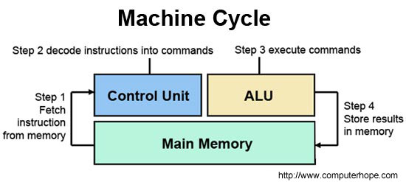
CONTROL UNIT

Slide 32
CONTROL UNIT
Microprogrammed control unit is a relatively simple logic circuit that is capable of;
sequencing through microinstructions and
(2) generating control signals to execute each microinstruction. The concept of microprogram is similar to computer program
The control unit initiate sequences of microoperations
Control signal (that specify microoperations) in a bus-organized system of groups of bits that select the paths in multiplexers, decoders, and arithmetic logic units

Slide 33
TYPES OF CONTROL UNIT
Two major types of Control Unit
Hardwired Control : Hardwired control is a control mechanism that generates control signals
Microprogrammed Control: Microprogrammed control is a control mechanism that generates control signals by reading a memory called a control storage (CS) that contains control signals

Slide 34
DIFFERENCE BETWEEN CONTROL UNITS
Hardwired Control unit | Microprogrammed control unit
It is a sequential circuit that generates control signals | It is a microinstructions in the control memory to generate control signals
Hardwired Control Units are difficult to modify, decode and implement | Microprogrammed Control Units are easier to modify, decode, implement and capable of handling complex instructions.
Operation execution is much faster. | Speed of operation is slow because it requires frequent memory access
To do any modifications the entire unit must be redesigned | Modifications can be implemented by changing the micro instructions in the control memory
More costly to implement | Less costly to Implement

Slide 35
Hardwired Control unit | Microprogrammed Control unit
It is difficult to handle complex instruction | It is easier to handle complex instruction
Use a small instruction set | Use a large instruction set
Used in the processors that use a simple instruction set known as RISC | Used in the processors based on CISC

Slide 36
MICRO PROGRAMMED CONTROL
Introduction
Microprogram :
Program stored in memory that generates all the control signals required to execute the instruction set correctly
Consists of microinstructions
Microinstruction:
It is the most elementary instruction in the computer, such as moving the contents of a register to the arithmetic logic unit (ALU).

Slide 37
CONTROL MEMORY
Control memory is a type of RAM (Random Access Memory) which contains addressable storage registers.
Data is temporarily store in control memory.
Control memory can be accessed quicker than main memory which speeds up CPU (Central Processing Unit) operations.
Control word is a set of ones and zeros in a control variable. The control memory contains control words.

Slide 38
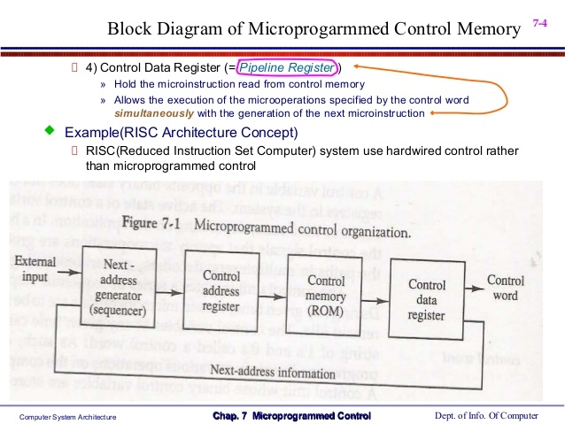
MICROPROGRAMMED CONTROL ORGANIZATION

Slide 39
MICROPROGRAMMED CONTROL
A memory is part of a control unit : Microprogram
Computer Memory (employs a microprogrammed control unit)
Main Memory : for storing user program (Machine instruction/data)
Control Memory : for storing microprogram (Microinstruction)
Control Address Register
Specify the address of the microinstruction

Slide 40
MICROPROGRAMMED CONTROL
Next Address Generator
Determine the address sequence that is read from control memory
Control Data Register ( Pipeline Register )
Hold the microinstruction read from control memory
Allows the execution of the microoperations specified by the control word simultaneously with the generation of the next microinstruction

Slide 41
ADDRESS SEQUENCING
Microinstructions are stored in control memory in groups, with each group specifying routine.
Each computer instruction has its own micro program routine in the control memory to generate the micro operation that executes the instruction
The hardware that controls the address sequencing of the control memory must be capable of sequencing the microinstructions within a routine and be able to branch from one routine to another
When all the execution of the instruction is completed control must return to the fetch routine
This is accomplished by executing an unconditional branch micro instruction to the first address of the fetch routine

Slide 42
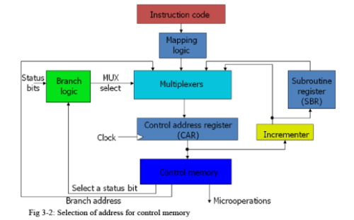

Slide 43


